Slide 1

Security+
Exam SY0-601
Chapter 13
Cybersecurity Resilience
Notes:
Gain Attention

Slide 2
Chapter 13 (Domain 2.5) Learning Objectives
Implement cybersecurity resilience.
Redundancy
Geographic dispersal
Disk
Redundant array of inexpensive disks (RAID) levels
Multipath
Network
Load balancers
Network interface card (NIC) teaming
Power
Uninterruptible power supply (UPS)
Generator
Dual supply
Managed power distribution units (PDUs)
Replication
Storage area network
VM
On-premises vs cloud
Backup types
Full
Incremental
Snapshot
Differential
Tape
Disk
Copy
Network-attached storage (NAS)
Storage area network
Cloud
Image
Online vs offline
Offsite storage
Distance considerations
Non-persistence
Revert to known state
Last know-good configuration
Live boot media
High availability
Scalability
Restoration order
Diversity
Technologies
Vendors
Crypto
controls

Slide 3
Redundancy
Redundancy is the use of multiple, independent elements to perform a critical function, so that if one element fails, there is another that can take over the work.
When developing a resiliency strategy for ensuring that an organization has what it needs to keep operating, even if hardware or software fails or if security is breached, you should consider other measures involving redundancy and spare parts.
Some common applications of redundancy include the use of redundant servers, redundant connections, and redundant ISPs.
Redundancy is an important factor in both security and reliability.

Slide 4
Geographic Dispersal
An important element to factor into the cost of the backup strategy is the expense of storing the backups.
Keep copies of backups in separate locations.
The most recent copy can be stored locally, as it is the most likely to be needed, while other copies can be kept at other locations.
A more recent advance is online backup services.
3-2-1 backup plan
3 copies on 2 different media with 1 saved offsite.

Slide 5
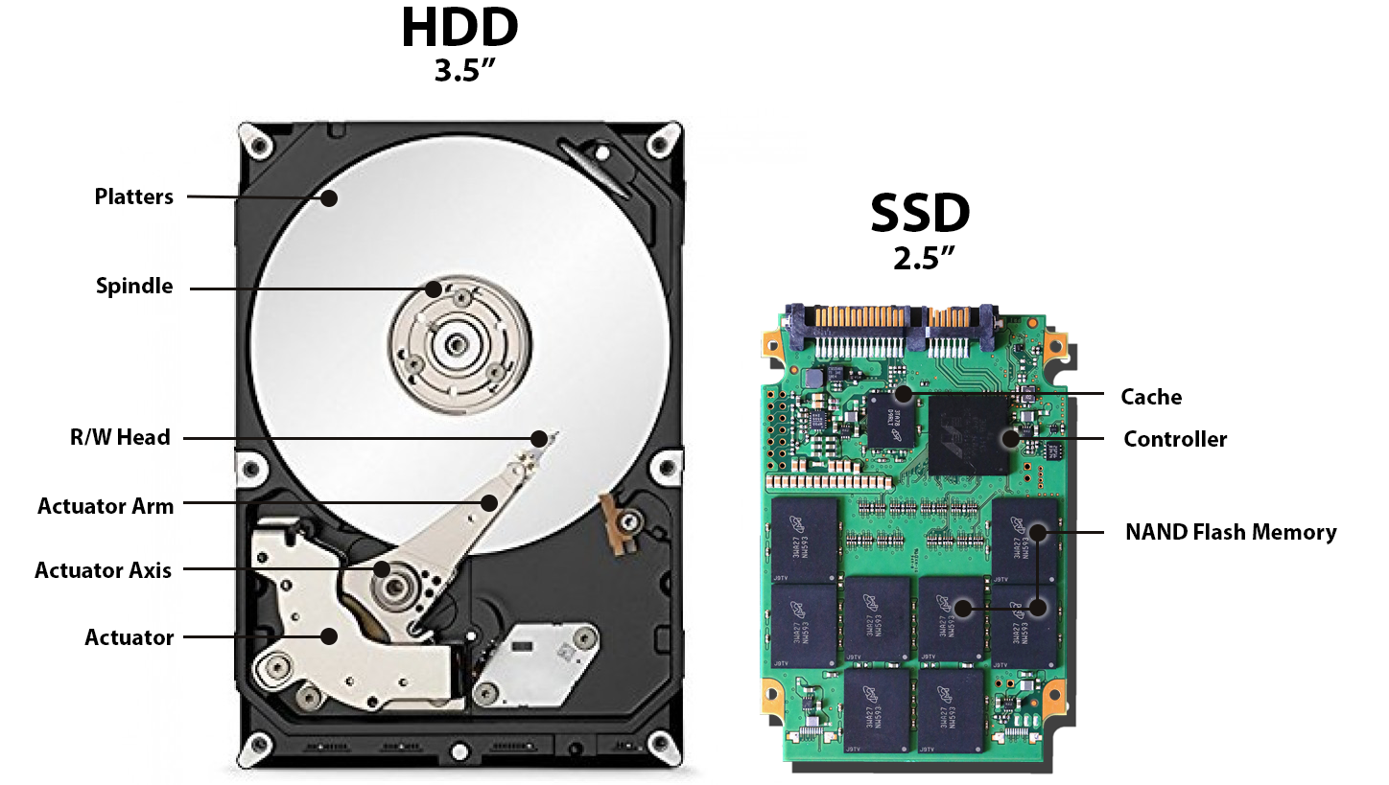
Disk
Disks are the primary storage mechanism in a system, whether composed of physical hard drives with spinning platters (HDD) or solid-state memory devices (SSD).
Notes:
Bring up NVME M.2

Slide 6
Redundant Array of Inexpensive Disks (RAID) Levels
A common approach to increasing reliability in disk storage is employing a redundant array of inexpensive disks (RAID).
RAID takes data that is normally stored on a single disk and spreads it out among several others.
If any single disk is lost, the data can be recovered from the other disks where the data also resides.
https://www.datapacket.com/blog/advantages-disadvantages-various-raid-levels
RAID 0 – Striping
RAID 1 – Mirroring
RAID 5 – Block-striped with parity bit
RAID 6 – Block striped with dual parity bits
Nested RAID levels:
RAID 0+1
RAID 1+0

Slide 7
Multipath
Between the storage systems and the server/computer is an I/O interface.
This I/O interface converts the information from the computer to a form that works for the specific storage system.
There are different interfaces for different types of storage systems (for example, RAID, SCSI, Fiber Channel, and SATA), each designed to deal with the necessary data transfers.
When a storage element is connected by multiple adapters, this provides redundancy in the event of a problem with one of the adapters.
This is referred to as a multipath connection and is commonly employed in high-reliability servers and critical systems.
Figure 13-1 shows a server with two host bus adapters (HBAs), along with two storage area network (SAN) switches and two RAID controllers.
This provides two independent paths from server to data.

Slide 8
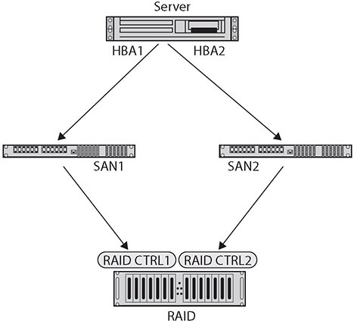
Multipath

Slide 9
Network
A network is the infrastructure element that connects all the IT components in the enterprise.
A network can serve as a point of failure, or it can be a system of redundant connections that can be resilient under various traffic loads and connectivity conditions.
Having a properly architected network that has multiple independent pathways and infrastructure elements designed to increase redundancy is important.
Two major elements to consider are load balancers and network interface card (NIC) teaming to remove some of the common modes of network-related traffic failures.

Slide 10
Load Balancers
A common technique used in fault tolerance is load balancing through the use of a load balancer, which moves loads across a set of resources in an effort not to overload individual servers.
This technique is designed to distribute the processing load over two or more systems.
It is used to help improve resource utilization and throughput but also has the added advantage of increasing the fault tolerance of the overall system since a critical process may be split across several systems.
Load balancing is often utilized for systems handling websites, high-bandwidth file transfers, and large Internet Relay Chat (IRC) networks.

Slide 11
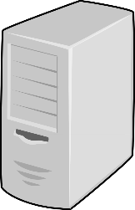

Load Balancers

Slide 12
Network Interface Card (NIC) Teaming
If a server has multiple network interface cards (NICs) connecting it to a switch or router, it will have multiple addresses, one for each NIC.
NIC teaming is an alternative means of connecting used by servers that have multiple network interface cards and wish to enjoy the benefits of load balancing, fault tolerance, and failover without requiring added infrastructure to do it.
NIC teaming groups multiple NICs together to form a logical network device called a bond. This provides for load balancing and fault tolerance.
If one or more of the connections have traffic issues or connectivity issues, the other NICs can carry the load.
Using NIC teaming allows your server to have redundancy and increased bandwidth, even in the event any of your physical adapters or cabling fails.

Slide 13
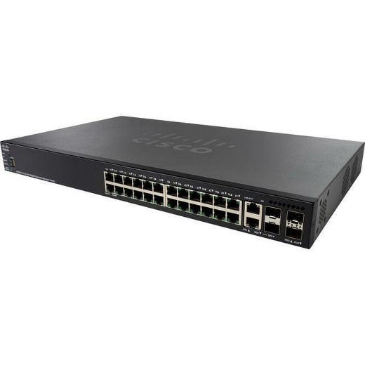
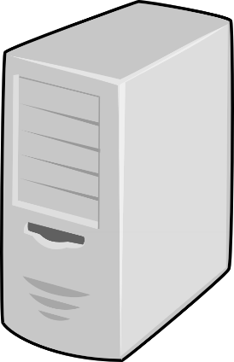
Network Interface Card (NIC) Teaming

Slide 14
Power
Uninterruptible Power Supply (UPS)
Uninterruptible power supplies (UPSs) are power supply systems that can function using a temporary battery backup in the event of a power failure.
UPSs typically do not have sufficient battery backup capability to last for long
Most UPSs are designed and rated for typically 20 minutes of runtime.
Generator
Backup generators are used to provide power when normal sources of electricity are lost.
The power for these devices is either natural gas or diesel, and they produce sufficient electrical power to cover the desired services during a power outage.

Slide 15
Power
Dual Supply
A dual supply is a system where two independent power supply units, either are capable of handling the load, are used.
In the event that either supply is lost, the other continues to carry the load.
Typically, these devices are also made to be hot swappable, so in the event of a failure, the bad supply can be replaced without powering down the unit.
Managed Power Distribution Units (PDUs)
A managed power distribution unit (PDU) is a device designed to handle the electrical power for server racks.
A fully populated server rack can use as much as 30kVA, or 10 times the amount of electricity for a typical home.
The objective of a PDU is to efficiently convert the power, and manage the heat from the conversion, while producing a power flow that is conditioned from spikes and over/under voltage conditions.

Slide 16
Replication
Replication is a simple form of redundancy—that is, having another copy of something should something happen to the original.
Dual power supplies replicate the power.
Having a redundant array of disks to store data is another form of replication, as are backups and having offsite alternate operations for business continuity purposes.
In situations where having something specific is essential, hearing someone say “two is one, and one is none” is a commonplace.
Common ways of seeing replication in everyday enterprise operations include the use of storage area networks and virtual machine technologies.

Slide 17
Storage Area Network (SAN)
A storage area network (SAN) is a dedicated network that connects compute elements to storage elements.
This network can be optimized for the types of data storage needed, in terms of size and data rates, in terms of format, and in terms of access criteria.
Having the old-school model of the data stored on disks attached directly to a machine represents a failure mode when the machine fails.
It also has issues when scaling to large quantities such as enterprise databases with multiple users.
The SAN resolves this point of failure by making the data storage independent of any individual computer and can even interface to multiple redundant storage systems to allow redundancy on the side of data storage as well.

Slide 18
VM
Virtual machine (VM) technologies can enable replication of processing units that can be manipulated between different computers.
VM technology allows multiple copies of a specific instance to be used on different hardware and with centralized monitoring and management.

Slide 19
On-premises vs. Cloud
When you’re examining redundancy, one factor to consider is location. Is the work going to happen on the premises or is it being done in the cloud?
By itself, this does not provide redundancy, but once the determination of location is made, then factors can be employed to ensure appropriate levels of redundancy based on risk.

Slide 20
Backup Types
A key element in business continuity/disaster recovery (BC/DR) plans is the availability of backups.
An organization might also find backups critical when security measures have failed, and an individual has gained access to important information that may have become corrupted or at the very least can’t be trusted.
The purpose of a backup is to provide valid, uncorrupted data in the event of corruption or loss of the original file or the media where the data was stored.
Four main forms of backups: full, incremental, differential, and snapshot.

Slide 21
Full Backup
The easiest type of backup to understand is the full backup.
In a full backup, all files and software are copied onto the storage media.
Restoration from a full backup is similarly straightforward—you must copy all the files back onto the system.
This process can take a considerable amount of time.
Consider the size of even the average home PC today, for which storage is measured in tens and hundreds of gigabytes.
Copying this amount of data takes time. In a full backup, the archive bit is cleared.

Slide 22
Incremental Backup
The incremental backup is a variation on a differential backup, with the difference being that instead of copying all files that have changed since the last full backup, the incremental backup backs up only files that have changed since the last full or incremental backup occurred, thus requiring fewer files to be backed up.
You first need the last full backup and reload the system with this data.
Then update the system with every incremental backup that has occurred since the full backup.
The advantage of this type of backup is that it requires less storage and time to accomplish.

Slide 23
Snapshot
A snapshot is a copy of a virtual machine at a specific point in time.
A snapshot is created by copying the files that store the virtual machine.
One of the advantages of a virtual machine over a physical machine is the ease with which the virtual machine can be backed up and restored—the ability to revert to an earlier snapshot is as easy as clicking a button and waiting for the machine to be restored via a change of the files.

Slide 24
Differential Backup
In a differential backup, only the files that have changed since the last full backup was completed are backed up.
This also implies that periodically a full backup needs to be accomplished.
Restoration from a differential backup requires two steps: the last full backup first needs to be loaded and then the last differential backup performed can be applied to update the files that have been changed since the full backup was conducted.
To perform a restore from differential backup, you need the last full backup and the most recent differential backup tape.

Slide 25
Tape Backup
Tape drives are an older form of data storage mechanism, and they are characterized by their sequential read/write access.
For general-purpose storage, this sequential access mechanism tends to create significant performance issues.
But for backups and restores, these operations are sequential in nature, and thus tape is still well suited for this type of operation.
For bulk storage of backups, tape is still a viable alternative in terms of cost and performance.

Slide 26
Disk Backup
The term disk refers to either a physical hard drive with spinning platters or a solid-state memory device.
Backing up a disk is a common operation for a single computer because most computers have very few disks, and this is a logical structure to maintain and restore.
For client-based PCs, a disk backup can make sense, and many systems can perform a full, incremental, snapshot, or differential backup of a disk.

Slide 27
Copy
Copying is the simplest form of backup for a file or set of files.
Users can use this option with ease, as the scope of their data backup requirement is typically small (for example, saving a copy of a critical document or an important picture).
However, this method breaks down when the scope expands to larger and larger sets of data, and for large-scale backups, one of the previous methods is more efficient both for backing up and restoring.
One of the advantages of having users make copies of critical documents is the ability to do a quick restore in the event of an overwrite error.

Slide 28
Network Attached Storage (NAS)
Network attached storage (NAS) is the use of a network connection to attach external storage to a machine.
This is a simple method of extending storage, and the connection can be managed over either a USB connection or the Ethernet network connection.
In either case, NAS is a simple extension of data storage to an external system, and typically these devices do not transfer data fast enough for regular operations.
However, they do work well as an external site for data-backup-and-recover solutions on a smaller, single-machine scale.

Slide 29
Storage Area Network (SAN)
A storage area network (SAN) is a dedicated network that connects compute elements to storage elements.
This network can be optimized for the types of data storage needed, in terms of size and data rates, in terms of format, and in terms of access criteria.
Using a SAN as part of a backup solution is a good example of using technology to solve complex problems.
Multiple different servers across the enterprise can connect via a SAN to a backup array, enabling efficient and effective backups in a manageable and flexible manner.

Slide 30
Cloud
Numerous cloud-based backup security vendors and products place the data storage of a backup in the cloud.
The advantages are all of the cloud advantages: offsite, can have multiple redundant copies, and available via the Web for recovery.
The disadvantages are the same: the backup is on another box, and it is protected only by the legal agreement between the user and the backup vendor.
Contracts tend to favor the backup vendor, not the client.

Slide 31
Image
An image-based backup is a specific structure of the backup file to match that of the system being backed up.
This may take more time and space, but it is also guaranteed not to miss anything because it backs up everything, including the deleted data and free space.
For critical systems, this provides a complete capture of the system as it was at the time of backup, including all nonpersistent data associated with the OS.
Image backups can provide extra levels of assurance when certain types of failures (due to a malware attack, for example) leave a system unusable.

Slide 32
Online vs. Offline
Online backups are those that are stored in a location that is accessible via the Internet.
This provides flexibility in recovery by making the backup data available anywhere there is a network connection.
Offline backups are those stored on an offline system that is not accessible via the Internet.
Online backups have the advantage of providing geographic separation of the backups from the original system.

Slide 33
Offsite Storage
Offsite backups are ones stored in a location separate from the system being backed up.
A building fire, a hurricane, a tornado—these are all disasters that occur frequently and typically affect more than just a single room or building.
Having backups offsite alleviates the risk of losing the backups to the same problem.
In today’s high-speed network world with cloud services, storing backups in the cloud is an option that can resolve many of the risks and issues associated with backup availability.

Slide 34
Distance Considerations
The distance associated with an offsite backup is a logistics problem.
The delay resulting from physical movement of backup tapes has been alleviated in many systems through networks that move the data at the speed of the network.
Distance is also critical when examining the reach of a disaster. It is important that the offsite location is far enough away that it is not affected by the same incident.
This includes the physical location of a cloud storage provider’s servers.

Slide 35
Nonpersistence
Nonpersistence refers to system items that are not permanent and can change.
An example of something that is nonpersistent is the registry in Microsoft Windows, which is a dynamic list of configuration criteria.
Nonpersistence needs to be appropriately managed, and systems that have this characteristic typically have mechanisms built in to manage this diversity.
For VMs, where the current state of the system is continually changing, and thus the image is changing, we have snapshots.
Snapshots provide a copy of the system at a point in time that you can then persist to use as a recovery point or backup.

Slide 36
Revert to Known State
Having the ability to recover to a known state is referred to as reverting to a known state.
Modern OSs are a prime example of non-persistence; they are regularly changing with new data, new software, new configurations, new drivers, and so on.
Many OSs have the ability to roll back to a previous known configuration: both servers and desktops can be rolled back, restoring the system to a previous point in time while leaving the files intact—back to a condition where the OS previously worked properly.

Slide 37
Last Known-Good Configuration
Microsoft Windows can give you an option to revert to the last known-good configuration, which is a means of reverting to a known state.
In Windows 7, this was a direct menu option.
In Windows 10, this option is buried under the Windows Recovery system. The methods of accessing it vary based on the type of issue, and whether or not you can get into Windows itself.
If Windows fails on three subsequent boots in sequence, it will present you with recovery options rather than trying to boot again.

Slide 38
Live Boot Media
One means of beginning with a known configuration and a known state is to boot to live boot media, which is a bootable flash drive or DVD source that contains a complete bootable image of the OS.
Using this as a means of starting in a known state is common in digital forensics investigations.

Slide 39
High Availability
High availability refers to the ability to maintain the availability of data and operational processing (services) despite a disrupting event.
Generally, this requires redundant systems, both in terms of power and processing, so that should one system fail, the other can take over operations without any break in service.
High availability is more than data redundancy; it requires that both data and services be available.
High availability refers to maintaining both data and services in an operational state, even when a disrupting event occurs.
Fault tolerance is a design objective to achieve high availability should a fault occur.

Slide 40
Scalability
Scalability is a design element that enables a system to accommodate larger workloads by adding resources either making hardware stronger (scaling up) or adding additional nodes (scaling out).
This term is commonly used in server farms and database clusters, as these both can have scale issues with respect to workload.
Both elasticity and scalability have an effect on system availability and throughput, which can be significant security- and risk-related issues.
Elasticity is related to dynamically scaling a system with workload (scaling out)
Scalability is a design element that enables a system both to scale up to more capable hardware and to scale out to more instances.

Slide 41
Restoration Order
Data restoration operations are designed to take an alternative copy of the data and put it back into a working system.
If you back up a database and then later need to use the backup to restore the database, this is data restoration.
But the order of restoration can make a difference.
It requires planning and coordination because the most important data needs to be identified and then backed up in a manner that facilitates its quick restore.
Developing a restoration plan, along with an order of what needs to be restored first, second, and so on, is important because this will drive certain operations when backing up the data in the first place.

Slide 42
Diversity
Having diversity in technologies, vendors, processes, and controls can assist in resiliency through differences in failure modes.
Building diversity into systems to allow parallel operations using different technologies, vendors, processes, and controls can provide a means to continue operation even during times of systems failures.

Slide 43
Technologies
The security industry has multiple technologies that can be employed across the enterprise in an effort to mitigate security risk.
Having firewalls, ACLs, bastion hosts in a screened subnet (DMZ), and network monitoring is an example of multiple technologies designed to detect unauthorized network activity.
Having a diverse set of these elements improves the chances of catching an attacker, even when they can beat one or two control elements.

Slide 44
Vendors
Different vendors approach security problems with different methodologies, different toolsets, different policies and procedures, and different technologies.
Adversaries have developed methods of beating different vendors, but if multiple vendors are brought into play, this makes it all that much more difficult for an adversary to bypass all of the employed options.
Having diversity in the vendors used for security prevents vendor-specific forms of single points of failure and creates a more robust set of defensive capabilities.

Slide 45
Crypto
For cryptographic solutions to work, both sides must agree on algorithms, keys, and other parameters, but diversity can still exist in this environment.
A prime example is in the TLS cipher suite, a set of different crypto protocols, preassigned to facilitate flexibility in establishing a connection.
When you establish a TLS-enabled connection, the server and client both negotiate a selection of protocol parameters from the preassigned list, enabling a secure connection to be established.

Slide 46
Controls
Defense in depth is a security principle where multiple layers of different security mechanisms are used to ensure catching a risk.
This is the use of diversity in controls. Modern networks employ not just a firewall but also a screened subnet (DMZ), bastion hosts, and ACLs, all working together in a coordinated fashion to make bypassing the entire suite of controls nearly impossible.

